Slide 1

Syrian Private University faculty of Artificial Intelligence Engineering Telecommunication Engineering
Project Title:
A Simulation-Based Model Design for High-Performance 5G Networks
Supervisor
Dr. Rawad Melhem
Prepared By
MHD.Nour Najeeb
LaithAbdAlrazek

Slide 2
Outline
Problem Statement.
Project objective.
Theoretical Fundamentals.
Literature Review Summary.
Project Plan.
Simulation & resulte.

Slide 3
Problem Statement
Traditional resource management in 5G cannot effectively handle the different and conflicting requirements of services like eMBB, URLLC, and mMTC at the same time.

Slide 4
Project Objective& Project Importance
Project Objective
A Simulation-Based Model Design for High-Performance 5G Networks.
Project Importance
Resource Optimization
Enabling Critical Applications
Foundation for Industry 4.0

Slide 5
Theoretical Fundamentals (1/3)
5G is not just "faster 4G."
5G supports three main service categories with conflicting requirements:
eMBB: high bandwidth and data rates.
URLLC: low latency and high reliability.
mMTC: massive device connectivity.

Slide 6
Theoretical Fundamentals (2/3)
Network Slicing:
The key 5G feature that enables these three services to coexist on the same physical hardware.
It creates isolated logical networks (slices) with customized resource allocation per service.

Slide 7
Theoretical Fundamentals (3/3)
KPIs :
eMBB | uRLLC | mMTC
Peak Data Rate | Latency | Connection Density
User Experienced Data Rate | Reliability | Network Energy Efficiency
Spectral Efficiency | Mobility

Slide 8
Literature review
Paper reference | principle | methodology | simulator
[1] Ochonu & Vidal, 2024 | Smart Factory Slice-aware Resource Allocation | Slicing with admission control protects critical URLLC traffic from eMBB congestion. | Custom MATLAB-based simulator.
[2] Zanbouri et al., 2025 | Indoor Industrial 5G-TSN Integration & Scalability | URLLC performance holds stable under increasing device density when slicing is applied. | OMNeT++ simulation framework.
[3] Bouroudi, Abdelmounaim... 2024 | Multi-domain scaling algorithm with inter-orchestrator communication | Machine learning-driven horizontal scaling approach for multi-domain network slicing orchestration | OMNeT++-based simulation

Slide 9
Project plan
Phase | Task | Status
1 | Theoretical study of 5G | ✅
2 | Literature review | ✅
3 | OMNeT++ and Simu5G training | ✅
4 | 5G model design (3GPP-compliant) | ⏳ Current
5 | Simulation and results analysis | ⬜
6 | Documentation | ⬜

Slide 10
Practical implementaion and results:
Equipment:
Processor Intel(R) Core(TM) i7-6500U CPU @ 2.50GHz 2.59 GHz
Installed RAM 8.00 GB
Softwere: omnet++, using Simu5G&inet

Slide 11
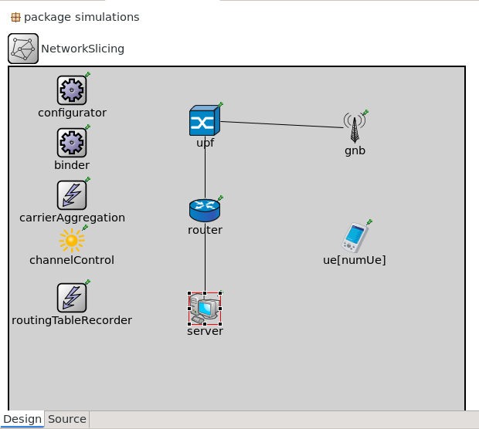
simulation & resulte
scenarios:
1- without mobiltiy
2-with mobility

Slide 12
